Slide 1












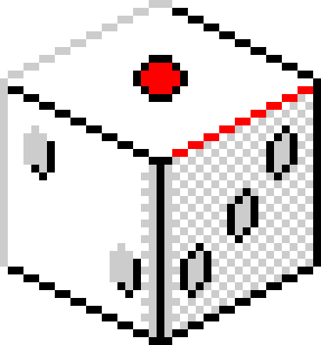



MONOCLICKER PROPOSAL
Incremental game
11:11PM

Slide 2
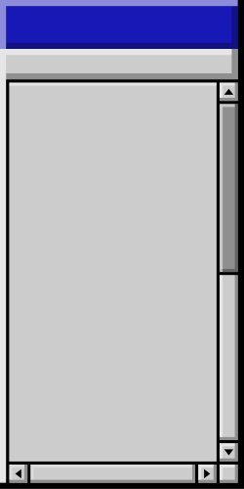
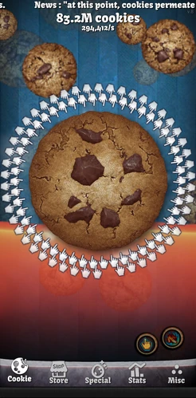
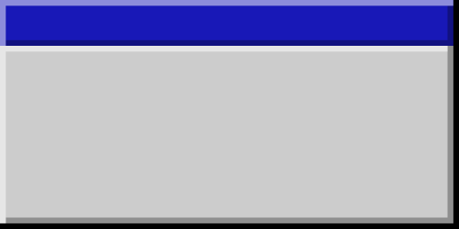
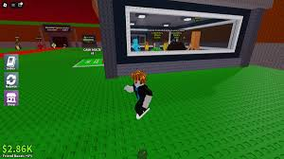
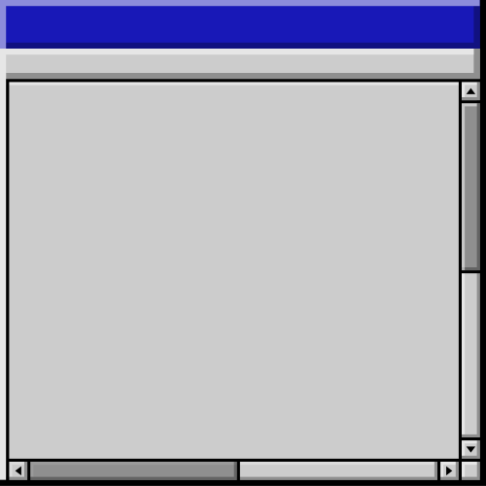
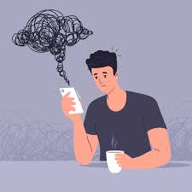
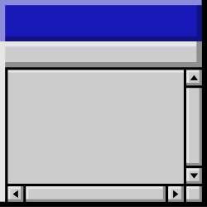
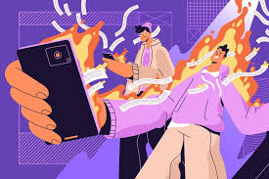


PROBLEM STATEMENT
  Most people are bored or get bored easily, but often turn to solutions that leave a negative impact on them (like doomscrolling). (Mental Health Foundation, 2025)
Back to Agenda Page

Slide 3
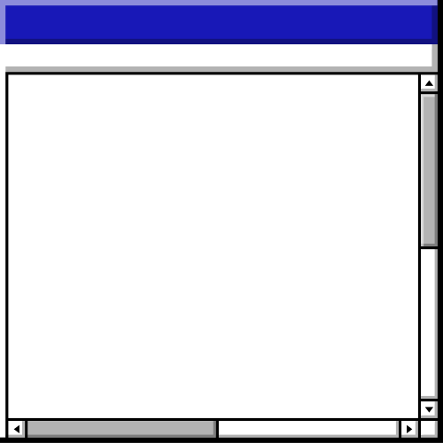
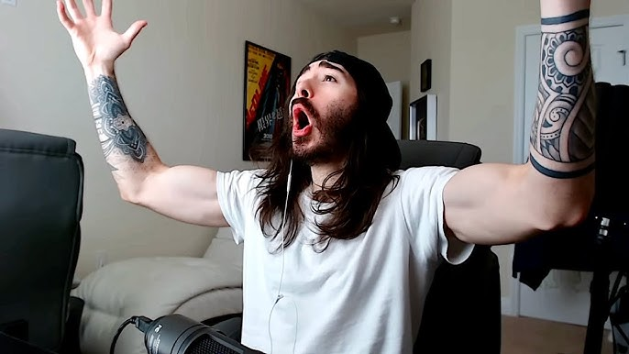

OBJECTIVES
MONOCLICKER
  Create a clean simulation experience for players to enjoy without too many unnecessary features.
  Destroy boredom and be a time-killer that isn’t too addictive.
YEAHH BABY
A NEW INCREMENTAL GAME
very fun game

Slide 4















FEATURES • FEATURES • FEATURES • FEATURES • FEATURES • FEATURES • FEATURES • FEATURES • FEATURES • FEATURES • FEATURES
PLANNED FEATURES
- Clickable button to increase a number (the user's G)
- Generators that the user can purchase with G to increase G output and can be accessed via the "Shop" button.
- Slight chance for generators to break down, and requires a "minigame" using a consistent stream of user input in a limited amount of time to "fix" the generator
- Tips at the bottom of the main menu to push along progress and give the user hints as to what to do
FEATURES • FEATURES • FEATURES • FEATURES • FEATURES • FEATURES • FEATURES • FEATURES • FEATURES • FEATURES • FEATURES

Slide 5
FEATURES • FEATURES • FEATURES • FEATURES • FEATURES • FEATURES • FEATURES • FEATURES • FEATURES • FEATURES • FEATURES
PLANNED FEATURES
- A timer that is put at the top of the screen that takes roughly 25% of the user's current G to slow down progress.
- An automatic save system that uses JSON files to store data, such as generator amounts, inflated prices, and the user's G.
- A menu used to upgrade and fix generators, accessed via the "Generator Status" button.
FEATURES • FEATURES • FEATURES • FEATURES • FEATURES • FEATURES • FEATURES • FEATURES • FEATURES • FEATURES • FEATURES

Slide 6

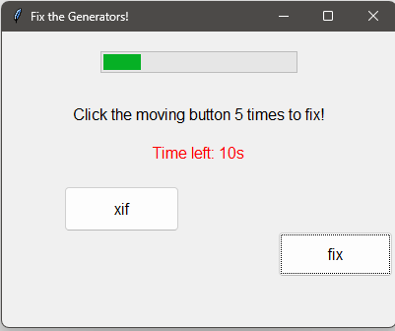
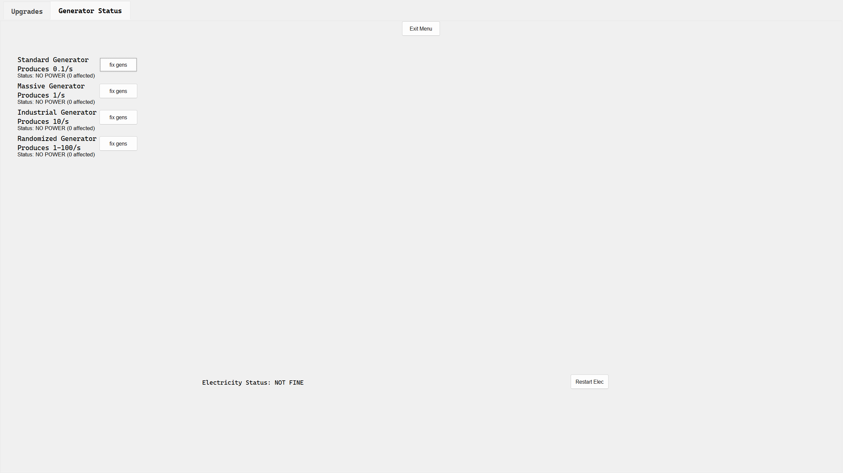

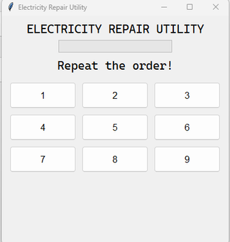

FEATURES • FEATURES • FEATURES • FEATURES • FEATURES • FEATURES • FEATURES • FEATURES • FEATURES • FEATURES • FEATURES
Generator Status in menu (Running)
Generator Status in menu
(No electricity)
Example Generator Fix Minigame
Electricity status in menu
(No electricity)
Generator Status in menu (Broken)
Generator Status in menu
(Not bought yet)
Electricity Fix minigame
(Memory Game)
FEATURES • FEATURES • FEATURES • FEATURES • FEATURES • FEATURES • FEATURES • FEATURES • FEATURES • FEATURES • FEATURES

Slide 7
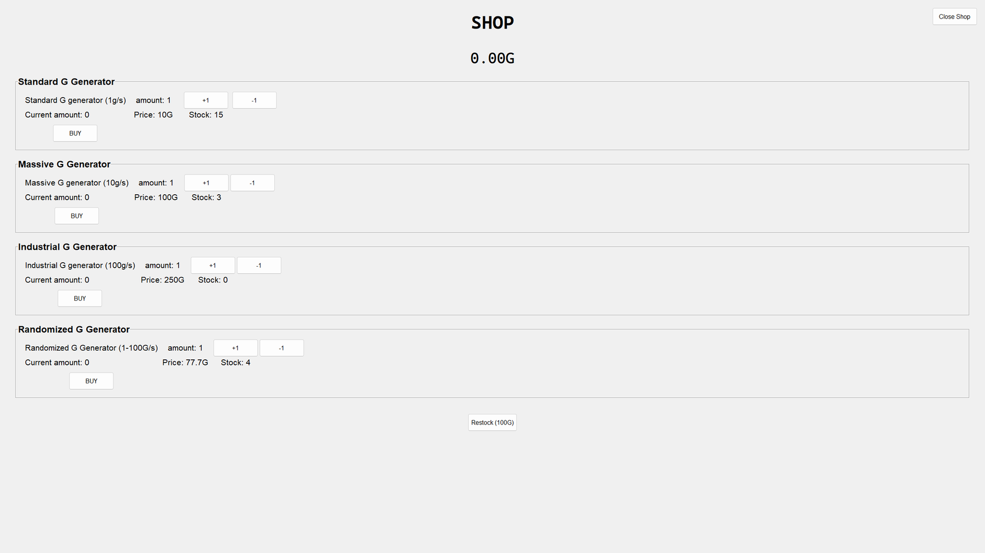
FEATURES • FEATURES • FEATURES • FEATURES • FEATURES • FEATURES • FEATURES • FEATURES • FEATURES • FEATURES • FEATURES
Shop Menu
FEATURES • FEATURES • FEATURES • FEATURES • FEATURES • FEATURES • FEATURES • FEATURES • FEATURES • FEATURES • FEATURES

Slide 8

FEATURES • FEATURES • FEATURES • FEATURES • FEATURES • FEATURES • FEATURES • FEATURES • FEATURES • FEATURES • FEATURES
Upgrade Menu
FEATURES • FEATURES • FEATURES • FEATURES • FEATURES • FEATURES • FEATURES • FEATURES • FEATURES • FEATURES • FEATURES

Slide 9
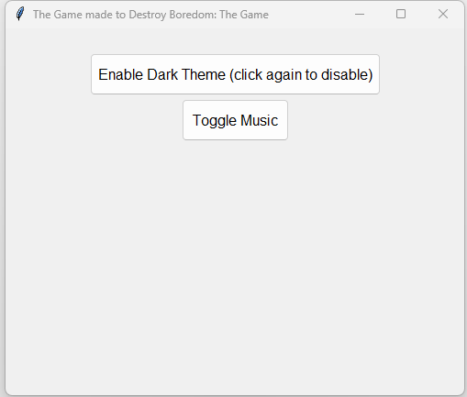
FEATURES • FEATURES • FEATURES • FEATURES • FEATURES • FEATURES • FEATURES • FEATURES • FEATURES • FEATURES • FEATURES
Settings Menu
FEATURES • FEATURES • FEATURES • FEATURES • FEATURES • FEATURES • FEATURES • FEATURES • FEATURES • FEATURES • FEATURES

Slide 10
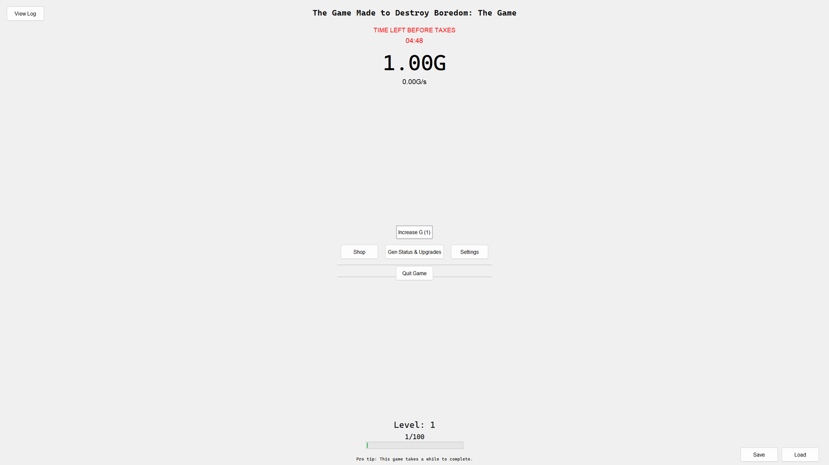
FEATURES • FEATURES • FEATURES • FEATURES • FEATURES • FEATURES • FEATURES • FEATURES • FEATURES • FEATURES • FEATURES
Main Menu
FEATURES • FEATURES • FEATURES • FEATURES • FEATURES • FEATURES • FEATURES • FEATURES • FEATURES • FEATURES • FEATURES

Slide 11

PLANNED INPUTS AND OUTPUTS
THIS IS A BRIEF GENERALIZATION OF ALL THE INPUTS AND OUTPUTS.
- User opens program and loads into menu
- Menu contains buttons that include a button to earn in-game currency in "g", a button to go to the shop in order to buy generators, and a status button that opens to check on the status of their generators and electricity and upgrade generators, as well as a timer at the top to indicate the time left before a percentage of their g is taken away forcefully.
- Generators are essentially objects that increase the user's "g" by an amount.
- Sometimes, generators will receive a tag that makes it stop producing g, forcing the user to "fix" generators by playing a minigame in the status menu.
- Electricity is a mechanic that disables ALL generators when it receives a tag to make it False.
- When reactivating electricity, the user has to a play another minigame, similar to fixing generators, but they have to play a memory game to restore it.
- This all happens simultaneously every "tick", 1/20th of a second that the game takes to perform every single action in that time.
Back to Agenda Page

Slide 12
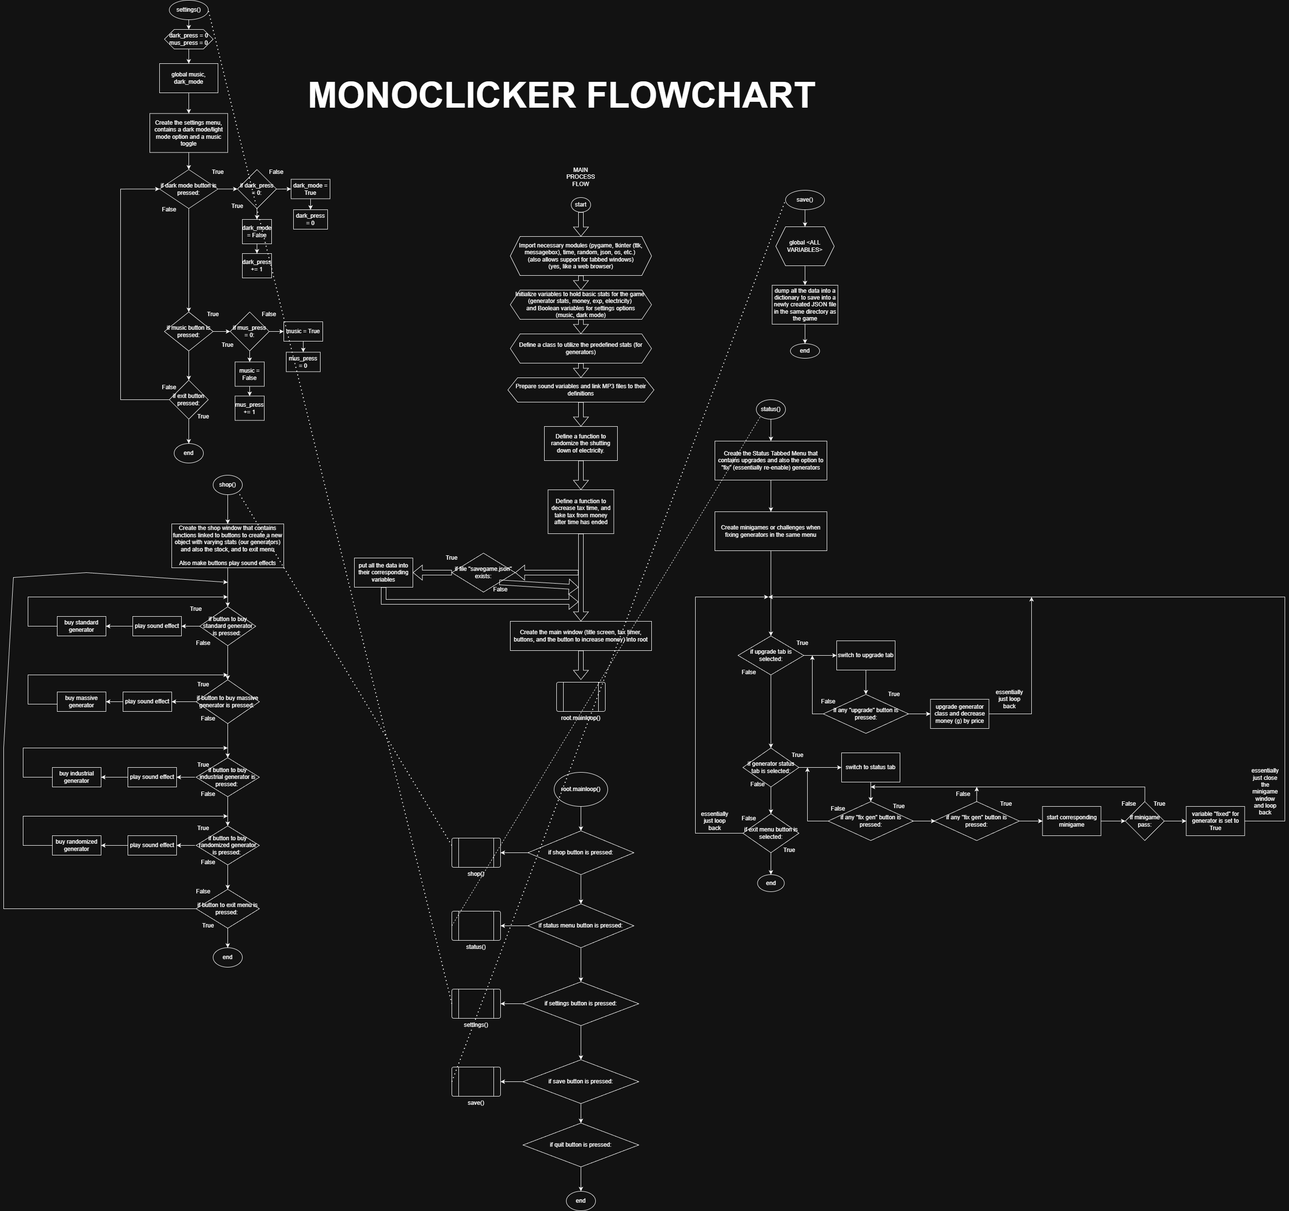
Shop menu

Slide 13
settings menu

Slide 14
Save button

Slide 15
Status menu and Generator Fix/Upgrade buttons

Slide 16
Main process flow (Main Menu and buttons)

Slide 17

Root.mainloop() (something tkinter has to keep everything running but GUI tools have the same function in a different name

Slide 18
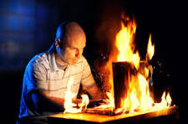
PSEUDOCODE

Slide 19
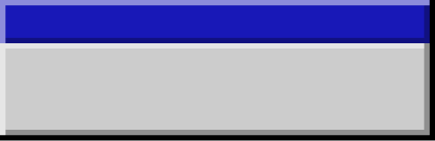

MAIN PROGRAM:
LOAD saved_data.json
INITIALIZE user_G, generators, electricity_status, timer, upgrades
CALL main_menu()
MAIN MENU LOOP
FUNCTION main_menu():
WHILE True:
CLEAR screen
DISPLAY "Current G: ", user_G
DISPLAY "Timer: ", timer.remaining_time
DISPLAY "Tips: ", random_tip()
DISPLAY BUTTONS:
[1] Earn G
[2] Shop
[3] Generator Status
[4] Exit Game
EVERY 1/20 second (TICK):
CALL tick_update()
IF button [1] clicked:
CALL earn_G()
IF button [2] clicked:
CALL open_shop()
IF button [3] clicked:
CALL generator_status_menu()
IF button [4] clicked:
CALL save_game()
EXIT program
  Loads save data
  Initializes user stats from data
  Calls main menu function
  Displays buttons
  Updates game stats every tick (1/20th of a second)
  Opens window corresponding to display button

Slide 20
GAME LOOP ACTIONS
FUNCTION tick_update():
IF electricity_status == True:
FOR each generator in generators:
IF generator.broken == False:
user_G += generator.output_rate / 20
ELSE:
CONTINUE # Skip broken generators
ELSE:
DISPLAY "Electricity Down! Fix to resume power!"
# Timer countdown
timer.remaining_time -= 1/20 second
IF timer.remaining_time <= 0:
user_G -= user_G * 0.25
RESET timer.remaining_time to default value
# Random chance for generator breakdown
FOR each generator in generators:
IF random_chance(0.001): # 0.1% chance per tick
generator.broken = True
EARNING G MANUALLY
FUNCTION earn_G():
user_G += 1
DISPLAY "+1 G"
Electricity manager
Time before taxes and timer
Generator break chance
Clicking button to gain G manually

Slide 21
SHOP MENU
FUNCTION open_shop():
WHILE True:
CLEAR screen
DISPLAY all available generators:
FOR each generator_type:
DISPLAY name, cost, output_rate, count_owned
DISPLAY "[B] Buy Generator | [E] Exit"
INPUT choice
IF choice == "B":
ASK which generator to buy
IF user_G >= generator.cost:
user_G -= generator.cost
generator.count_owned += 1
INCREASE generator.cost by inflation_rate
ELSE:
DISPLAY "Not enough G!"
IF choice == "E":
BREAK

Slide 22
INPUT choice
IF choice == 1:
ASK which generator to fix
IF generator.broken == True:
CALL fix_minigame(generator)
ELSE:
DISPLAY "That generator is already working!"
IF choice == 2:
ASK which generator to upgrade
IF user_G >= generator.upgrade_cost:
user_G -= generator.upgrade_cost
generator.output_rate *= 1.2
generator.upgrade_level += 1
generator.upgrade_cost *= 1.5
IF choice == 3:
IF electricity_status == False:
CALL electricity_memory_game()
ELSE:
DISPLAY "Electricity is already active!"
IF choice == 4:
BREAK
GENERATOR STATUS MENU
FUNCTION generator_status_menu():
WHILE True:
CLEAR screen
DISPLAY each generator:
name, output_rate, broken_status, upgrade_level
DISPLAY BUTTONS:
[1] Fix Generator
[2] Upgrade Generator
[3] Fix Electricity
[4] Exit

Slide 23
MINIGAMES
FUNCTION fix_minigame(generator):
DISPLAY "Fixing generator... Type the shown letters quickly!"
SET timer = 5 seconds
WHILE timer > 0:
DISPLAY random letter
WAIT for user input
IF user input matches:
CONTINUE
ELSE:
DISPLAY "Failed! Try again."
RETURN
DISPLAY "Generator fixed!"
generator.broken = False
FUNCTION electricity_memory_game():
DISPLAY "Memory Restore Game!"
GENERATE sequence of 5 random letters
DISPLAY them for 3 seconds
CLEAR screen
ASK user to type the sequence
IF correct:
DISPLAY "Electricity Restored!"
electricity_status = True
ELSE:
DISPLAY "Failed! Try again later."

Slide 24
SAVE AND LOAD SYSTEM
FUNCTION save_game():
data = {
"user_G": user_G,
"generators": list of generator states,
"electricity_status": electricity_status,
"timer": timer.remaining_time
}
WRITE data TO "saved_data.json"
FUNCTION load_game():
IF "saved_data.json" exists:
READ data
user_G = data["user_G"]
generators = data["generators"]
electricity_status = data["electricity_status"]
timer.remaining_time = data["timer"]
ELSE:
INITIALIZE default values
TIPS SYSTEM
FUNCTION random_tip():
tips = [
"Click the G button to earn G!",
"Buy generators to automate G generation.",
"Keep an eye on your generators — they can break!",
"Don’t forget to restore power when it goes out."
]
RETURN random choice from tips

Slide 25
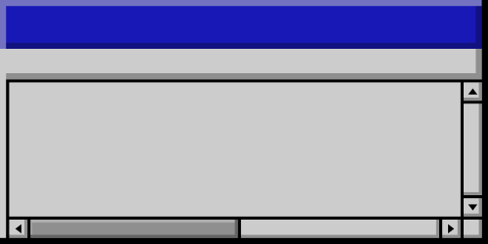
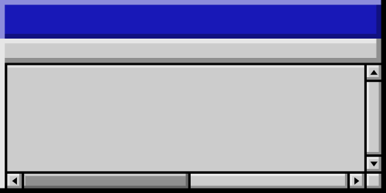

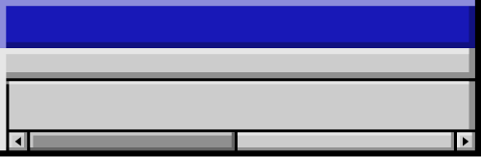
Thank you!
Github Link:
https://github.com/xbbatingkay-hub/camia-BatingkayOlympia

Slide 26



Resource
Page
Use these design resources
in your Canva Presentation.
Happy designing!
Don't forget to delete
this page before presenting.

Slide 27





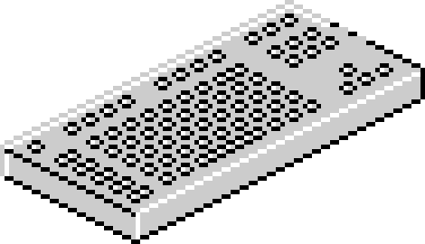







Resource
Page
Use these design resources
in your Canva Presentation.
Happy designing!
Don't forget to delete
this page before presenting.

Slide 28
B for blur | C for confetti
D for a drumroll | M for mic drop
O for bubbles | Q for quiet
U for unveil | Any number from 0-9 for a timer
Resource
Page
Find the magic and fun in presenting with Canva Presentations. Press the following keys while on
Present mode!
Delete this page before presenting.

Slide 29
Go to Uploads, then Record Yourself.
All recordings will be saved on Canva in your Uploads folder.
Edit your recording. Feel free to adjust the background, volume, and duration.
Need multiple presenters? Select Share then update Collaboration link to Can edit.
Share editable link. Assign team members to record their sections.
You can also mix live presentation and recorded videos to make your session more engaging.
Resource
Page
Want more flexibility as a presenter? Record your presentation to engage
in a way that works for you — and let your audience watch in a way that
works for them.
Delete or hide this page before sharing.

